Slide 1
Development of dentition & occlusion

Slide 2
Development of teeth

Slide 3
TOOTH DEVELOPMENT
Oral octoderm – 6th week – Dental lamina - proliferations – knobs – future enamel organs.
All teeth originate from the dental lamina.

Slide 4
Direct proliferation of dental lamina results in the formation of teeth

Slide 5
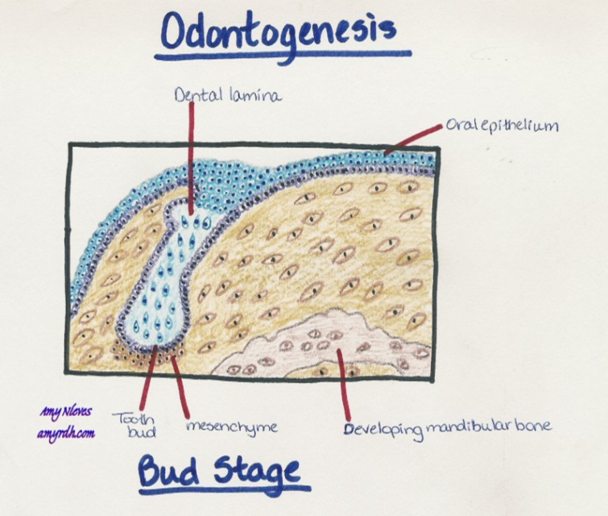
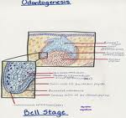
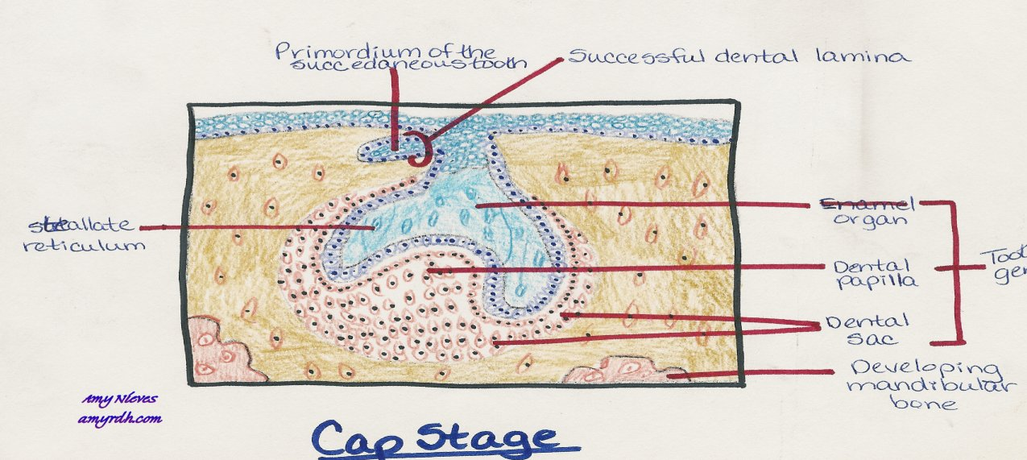
1. bud stage
2. cap stage
3. bell stage

Slide 6
Root development
Begins after the dentin and enamel formation reach the future cemento enamel junction
The outer and the inner enamel epithelium join to form the Hertwig’s epithelial root sheath.

Slide 7
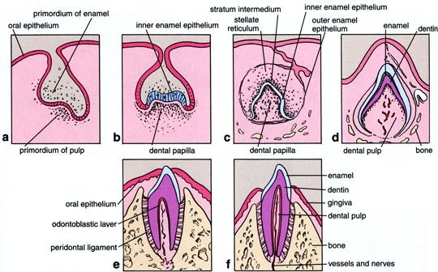

Slide 9
Development of occlusion

Slide 10
STAGES OF DEVELOPMENT….
THE PRE DENTATE PERIOD – birth to 2 ½ yrs
THE DECIDUOUS DENTITION PERIOD - 2 ½ -6 yrs
THE MIXED DENTITION PERIOD – 6 – 12 yrs
THE PERMANENT DENTITION PERIOD - above 12 yrs

Slide 11
Pre dentate period…
Birth to six months of age
Gum pads :
The alveolar process at the time of birth are known as gum pads

Slide 12
They are horse shoe shaped and develop into two parts - labial portion and lingual portion
Two portions are separated from each other by the dental groove

Slide 13
Features at this stage…
Open bite – common in gum pad stage
Contact seen only in molar region
During first year of life the gum pads grow rapidly permitting the incisors to erupt in good alignment.
Lower central incisor is the first tooth to erupt at 6 - 7 months of age
Eruption is completed by 2 1/2 - 3 yrs
The teeth that are present at the time of birth are called natal teeth.
The teeth that erupt during the first month of age are called neo natal teeth.

Slide 14
The deciduous dentition period
The initiation of primary tooth buds occurs during the first six weeks of intra uterine life
The primary teeth begin to erupt at the age of six months.

Slide 15
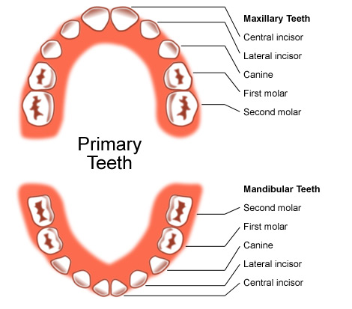
Eruption sequence of primary dentition

Slide 16
Spacing in the primary dentition
Physiologic spaces
Primate spaces

Slide 17
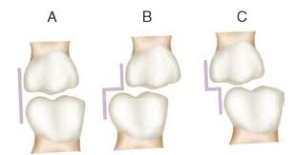
Flush terminal plane
Normal feature of deciduous dentition.
The mesio distal relation between the distal surfaces of the upper and the lower second deciduous molar is called TERMINAL PLANE

Slide 18
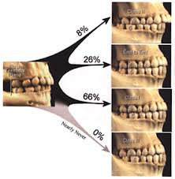

Slide 19
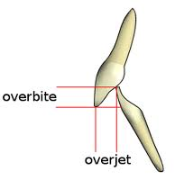
Overjet and overbite
Overbite in primary dentition – 10 – 40%
Open bites common in this group – due to oral habits
Overjet in primary dentition – 0 – 4 mm
Increased overjet primarily due to habits.

Slide 20
The mixed dentition period
3 phases:
1. FIRST TRANSITIONAL PERIOD
2. INTER TRANSITIONAL PERIOD
3. SECOND TRANSITIONAL PERIOD

Slide 21
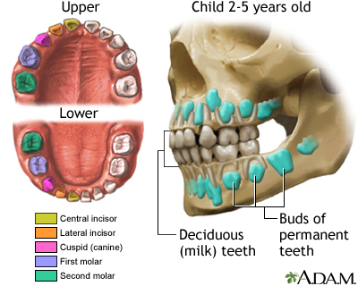
First transitional period :
Emergence of the first permanent molar and the exchange of the deciduous incisor.
The first permanent molar guided by the distal surface of the second deciduous molar

Slide 22
The mesio distal relation ship of distal surface of second deciduous molar is classified into three types
1. FLUSH TERMINAL PLANE
2. MESIAL STEP TERMINAL PLANE
3. DISTAL STEP TERMINAL PLANE
FLUSH TERMINAL PLANE to class I molar
1. Early mesial shift
2. Late mesial shift

Slide 23
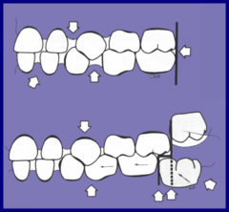
EARLY MESIAL SHIFT
The eruptive force of the first permanent molar is sufficient to push the deciduous first and second molars forward in the arch to close the primate space and there by establish a class I molar relation ship
This occurs in mixed dentition period and it is called early mesial shift

Slide 24
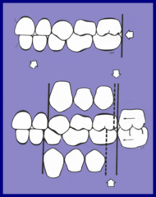
LATE MESIAL SHIFT:
Many children lack the primate space and thus the erupting permanent molars are unable to move forward to establish class I relationship
In this case when the deciduous second molar exfoliate the permanent first molars drift mesially utilizing the leeway space and this is called late mesial shift .

Slide 25
Mesial step terminal plane:
In this type of relation ship the distal surface of the lower second deciduous molar is more mesial to than that of the upper

Slide 26
Distal step terminal plane:
This is characterised by the distal surface of the lower second deciduous molar being more distal to that of the upper
Thus the erupting permanent molars will be in Angles class II occlusion

Slide 27
Causes of change in molar relationship
1. Leeway space
2. Mandibular growth

Slide 28
EXCHANGE OF INCISORS:
During the first transitional period the deciduous incisors are replaced by the permanent incisors.
The permanent incisors are considerably larger than the deciduous incisors they replace.
The difference between the amount of space needed is called INCISAL LIABILITY.

Slide 29
The incisal liability is over come by the following factors:
A. Utilization of inter dental spaces
B. Increase in inter canine width
C. Change in incisor inclination

Slide 30
Inter transitional period:
In this period,the maxillary and the mandibular arches consists of set of deciduous and permanent teeth.
Between the permanent incisors and the first permanent molars are the deciduous molars and canines.
This phase during the mixed dentition period is relatively stable and no change occurs.

Slide 31
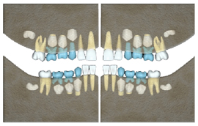

Slide 32
Second transitional period:
It is characterized by the replacement of the deciduous molars and canines by the premolars and permanent cuspids.
LEWWAY SPACE:
The combined mesiodistal width of the permanent canines and premolars is usually less than that of the deciduous canines and molars. This excess space is called Leeway space of Nance.
It is about 1.8mm in the maxillary arch and 3.4mm in the mandibular arch .

Slide 33
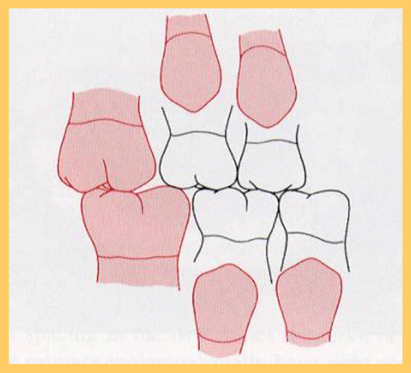
LEEWAY SPACE

Slide 34
Ugly duckling stage :
Transient or self correcting malocclusion.
8-9yrs of age .
seen during the eruption of the permanent canines
Developing permanent canines displace the roots of the lateral incisors mesially.
This results in transmitting of the force on the roots of the central incisors which also gets displaced mesially
A resultant distal divergence of the crowns of the two central incisors causes a midline spacing

Slide 35
This situation has been described by Broadbent as the ugly duckling stage.

Slide 36
Ugly duckling stage

Slide 37
The permanent dentition period
The permanent dentition forms with in the jaws soon after birth, except for the cusps of the first permanent molars which forms before birth.
The permanent incisors develop lingual or palatal to the deciduous incisors and move labially as they erupt.
The premolars develop below the diverging roots of the deciduous molars

Slide 38
Thank you

